Slide 1
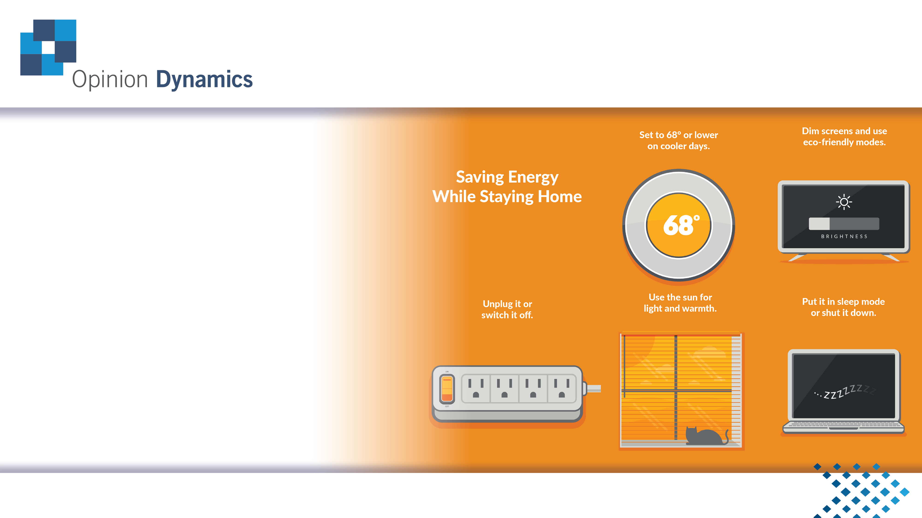
CPUC COVID-19 Customer support ME&O General Population Survey Report
CALMAC Study ID: CPU0217.01
June 30, 2020

Slide 2
Table of Contents
Executive Summary (3)
Campaign Overview (4)
Survey Methodology (5)
Research Objectives (6)
COVID 19 Impacts (10)
Energy Upgrade California (EUC) Awareness & Familiarity (13)
EUC Brand Perception (18)
Assessing Californians’ Reactions to the Covid-19 Customer Support Campaign (21)
Perceptions, Attitudes, and Intentions Regarding Energy Management (32)
Changes In Media Consumption (46)
Californians’ Identity as Californians (50)
Implications of the Research Findings to EUC (52)
Appendix (60)

Slide 3
Executive Summary
Californians responded positively to the COVID-19 Customer Support Campaign
A modest percentage of Californians are taking the recommended energy-saving tips
Californians are facing new energy conservation barriers during the pandemic, which have disproportionate impacts across customer groups
There are opportunities for improvement in COVID-19 Customer Support Campaign messaging and outreach strategies

Slide 4
Executive Summary Continued
Respondents most financially affected by the pandemic were more likely to:
  Be aware of the COVID-19 Customer Support campaign tips and ads, EUC, and the Keep it Golden Slogan, and to have heard about the impact of the SIP order on Californians’ utility bills
  Evaluate the campaign ads as useful, relevant, reasonable, fair, and interesting
  Say the mission of EUC is relevant, that the people of CA need a campaign like EUC right now, and that they can trust EUC
  Indicate they want to save more energy to reduce their bills during this time
  Be concerned with managing their energy use
  Say it is important for their household to do its part to make CA more energy efficient
  Say there are things they could change in terms of the day-to-day actions and home energy upgrades to save energy
  Report having a greater likelihood of making home efficiency upgrades and changes their day-to-day actions to save energy
Demographically, respondents most affected by the pandemic were more likely to:
  Be non-white and lower income

Slide 5
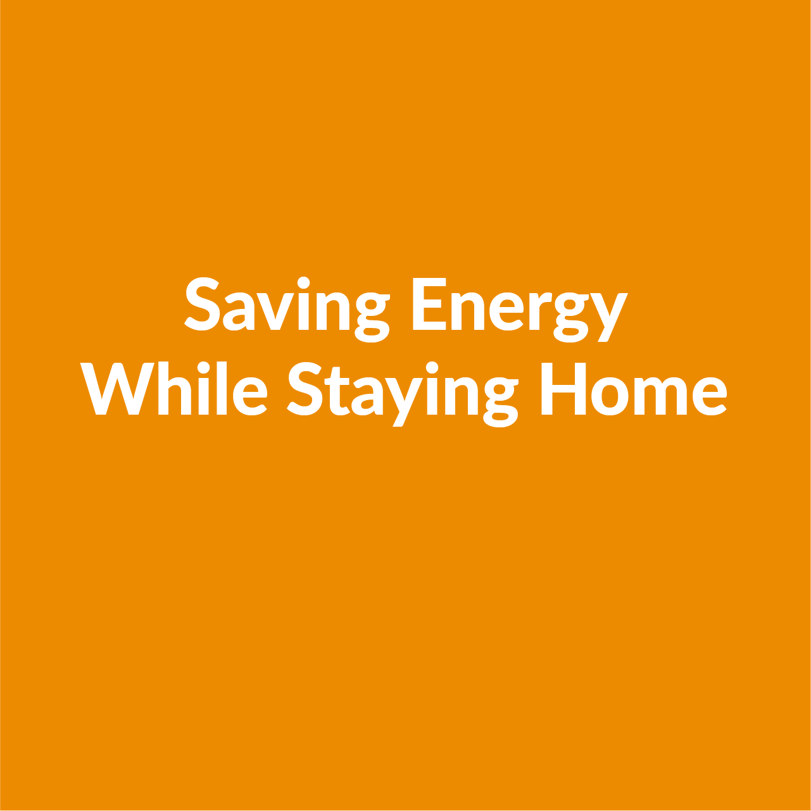
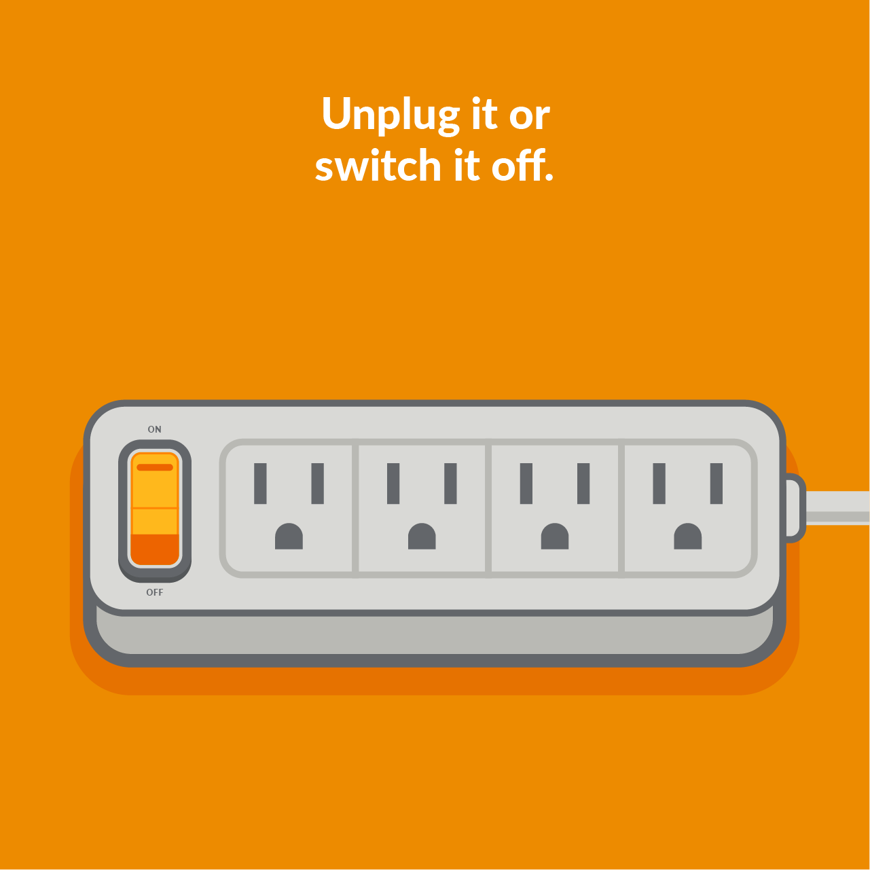
COVID-19 Customer Support Campaign Overview
The CPUC and the DDB Group deployed a multi-channel campaign positioning Energy Upgrade California as a helpful resource to the public during California’s Shelter-in-Place (SIP) (April 6th through 30th)
Overarching messages:
  With millions of Californians staying at home, residential energy use has increased - and utility bills may go up
  Simple, no-cost energy behaviors can help us save energy and money during this difficult time
Campaign channels include TV, digital media (YouTube), social media (Instagram and Facebook), newspapers, and paid search

Slide 6
Survey Methodology
Opinion Dynamics conducted a bilingual online survey of 2,000 Californians
Sample drawn from YouGov’s non-probability opt-in panel. Results are weighted to be representative of state of CA population based on gender, age, race, home-ownership, education, and income using propensity score matching
Respondents could complete the interview in either English or Spanish
  English: 1444 (72%)
  Spanish: 556 (28%)
Field dates: May 21st to June 2nd
Findings from previous biannual residential customer surveys conducted in Fall 2017, June 2019, and March 2020 are included for historical context
  Previous surveys used probability-based samples and fielded using mail-push-to web method. This difference in sample methodology may contribute to variations in results between the May 2020 survey and previous surveys

Slide 7
Research Objectives and Research Questions
Research Objectives | Research Questions and Metrics
COVID-19 Impacts | How has the COVID-19 Pandemic impacted Californians?
Understanding how the EUC brand is perceived | Aided and unaided awareness of EUC and the Keep it Golden Slogan How much do Californians appreciate EUC at this time? How relevant is the mission of EUC to Californians? How much do Californians need EUC? How much is EUC trusted by Californians?
Understanding the extent to which the campaign is reaching Californians | Aided awareness of specific pieces of campaign content (e.g. TV ad and social media posts) Have Californians seen or heard anything about how to save energy at home while sheltering in place? Where are Californians learning about tips to save energy at home while sheltering in place? Are Californians aware that their bills might increase?

Slide 8
Research Objectives and Research Questions (continued)
Research Objectives | Research Questions and Metrics
Assessing Californians’ attitudes towards campaign content and messaging | How does the campaign content and messaging make Californians feel? (e.g. assured, comforted, annoyed, anxious) What are customers’ attitudes towards what the state is asking them to do?
Understanding Californians’ energy saving actions and behaviors | Are Californians taking actions recommended by the COVID-19 Support Campaign?
Assessing Californians’ perceptions, attitudes, and intentions regarding energy management | How likely are they to adopt the COVID-19 Support Campaign-targeted actions? Do Californians believe it is important to save energy at this time? How often do Californians make efforts to live in ways to reduce energy use? Do Californians perceive that they play an important role in making California more energy efficient? How concerned are Californians with managing their energy use? How likely are Californians to attempt to change their-day-to day actions to save energy?

Slide 9
Research Objectives and Research Questions (continued)
Research Objectives | Research Questions and Metrics
Understanding changes in media consumption | From which sources do Californians get their information and how many hours do Californians spend using those information sources? Level of trust in information/media sources
Understanding Californians’ connection to their state | Do residents feel strong ties to other Californians? How important is being a Californian to residents’ identity? How important is it to Californians to do their part to make California more energy efficient?

Slide 10


COVID 19 IMPACTS

Slide 11
Respondent characteristics related to COVID-19
30% of respondents are essential workers
40% have at least one person under the age of 18 in their household
42% have heard of the California Alternative Rates for Energy (CARE) program
53% are at higher risk for major health-complications if they were to get COVID-19

Slide 12
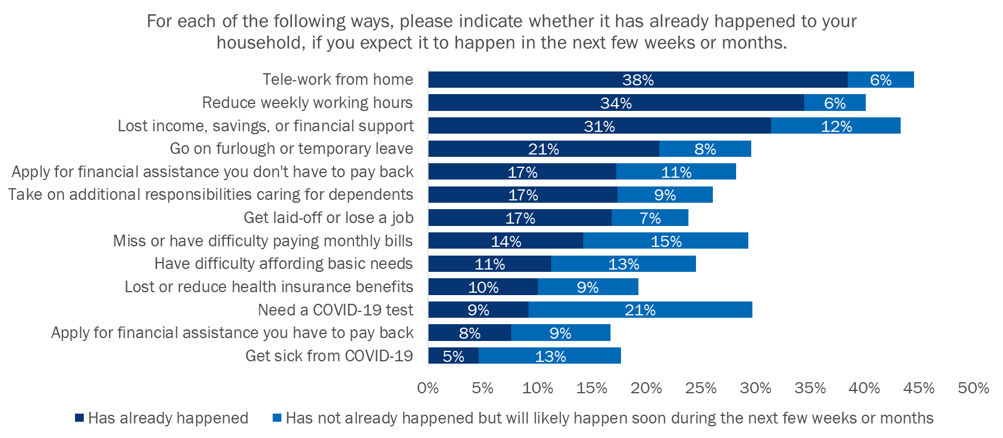


Respondents have experienced multiple COVID-19 impacts
Pandemic-affected respondents are defined hereafter as any respondent who selected any of these marked events that happened or will likely happen soon.
Note: Multiple responses were allowed.

Slide 13

ENERGY UPGRADE CALIFORNIA (EUC) AWARENESS & FAMILIARITY

Slide 14
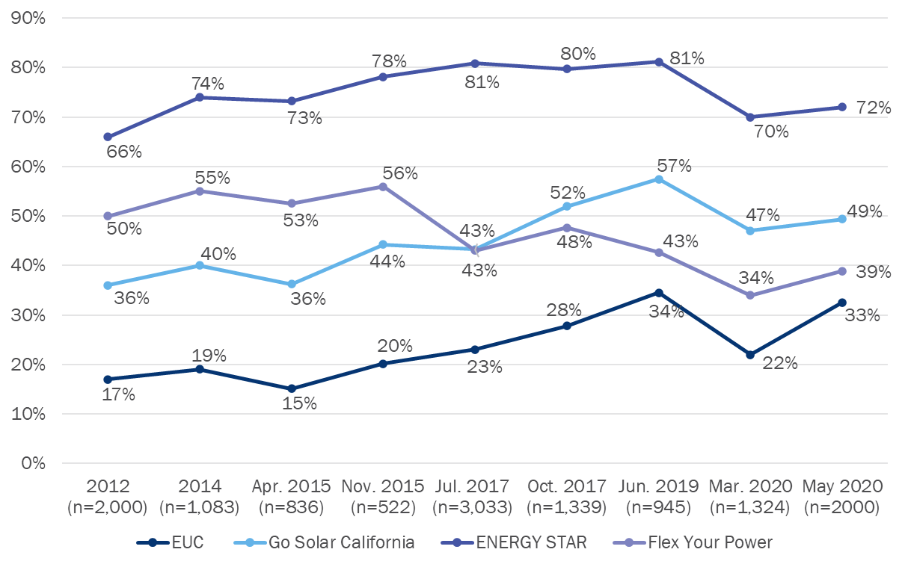
Aided Awareness of EUC and all other brands increased since March
One in three Californians (33%) reported they were aware of EUC when prompted with the brand name
Awareness of all brands, especially EUC, increased since the last survey in March
For each one, please tell us if you have heard of it before today.
Methodologies
2012 RDD
2014 YouGov web panel
2015 YouGov web panel
Jul 2017 YouGov web panel
Oct 2017 ABS web
Jun 2019 ABS web
Mar 2020 ABS web
May 2020 YouGov web panel

Slide 15

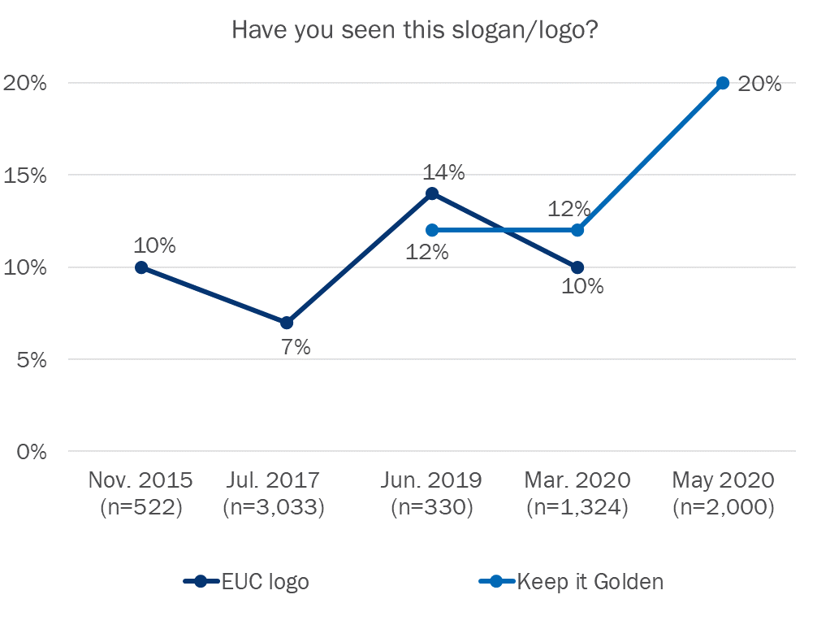

Aided recognition of the Keep it Golden slogan increased since March; unaided awareness has stayed about the same
‘Keep It Golden’ slogan recognition rate increased to 20%
  1.1% of all respondents correctly associated the slogan with EUC unaided
  Compared to March 2020 when 1.4% of all respondents correctly associated it with EUC

Slide 16
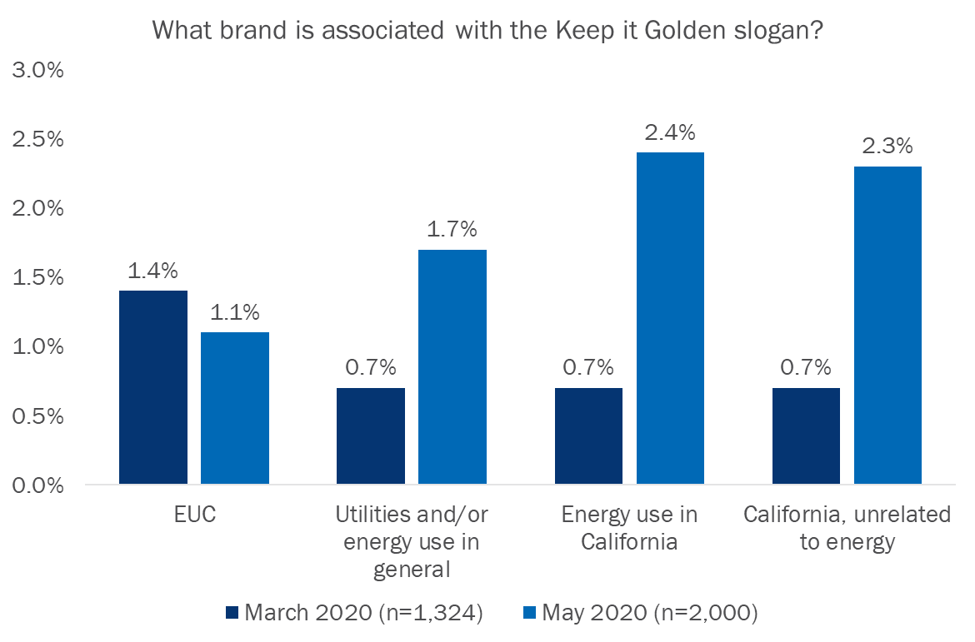
Most respondents that recognized the slogan associate it with energy-related topics, though some think it represents the state of CA and tourism

Slide 17
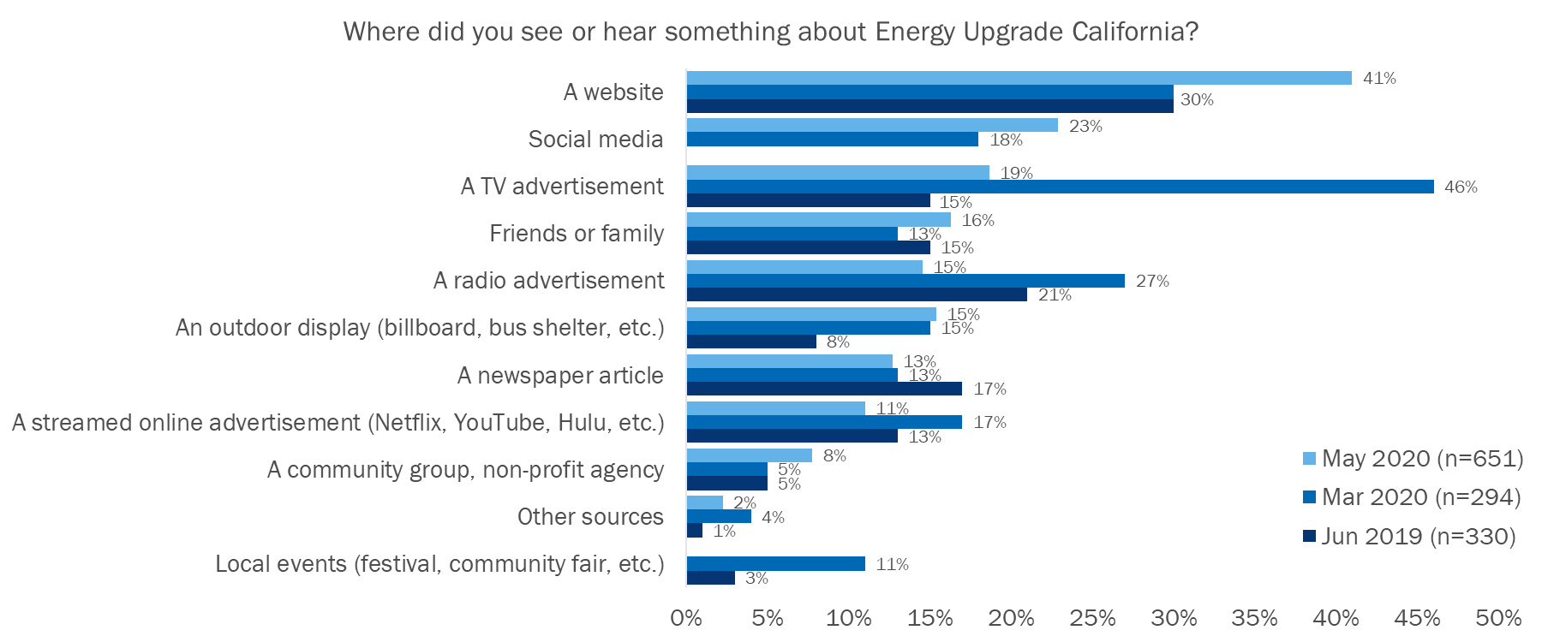
Websites and social media, are the most common channels for hearing about EUC, and both have increased since March
Note: Multiple responses were allowed.
DDB spend for paid search increased by 15% in May, driven primarily by an increase in COVID-related search terms as interest grew around relevant “money saving tips”
COVID keywords included: money savings, working from home tips, essentials for working from home

Slide 18
EUC BRAND PERCEPTION

Slide 19
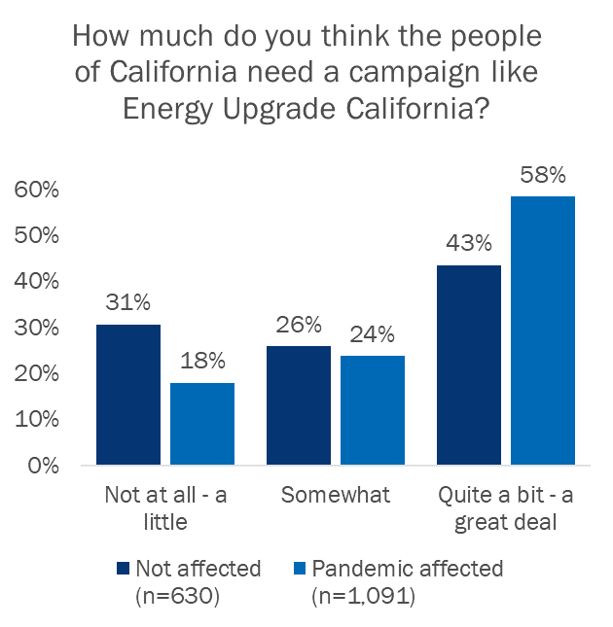
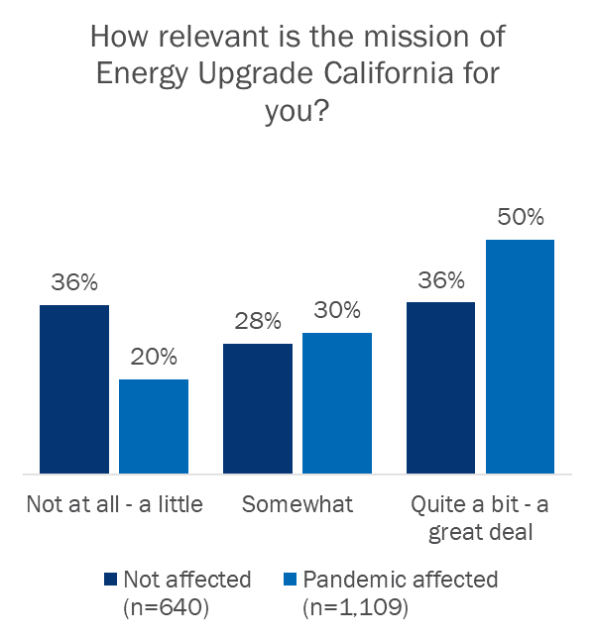
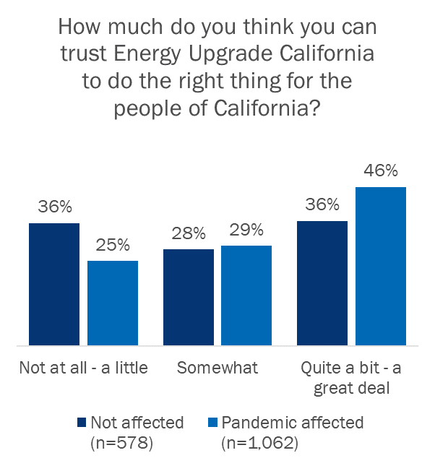
Pandemic-affected respondents were more likely to believe EUC is needed and relevant and have higher levels of trust in EUC
EUC mission description: Energy Upgrade California is a statewide campaign with a mission to help Californians better manage their energy use by providing tools, knowledge, and inspiration. The campaign is a partnership between the State of California, utilities, regional energy networks, local governments, community choice aggregators, businesses, and non-profits.

Slide 20
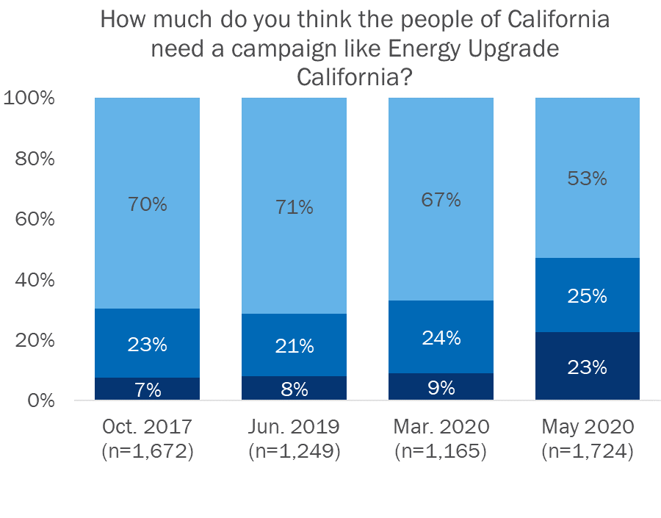
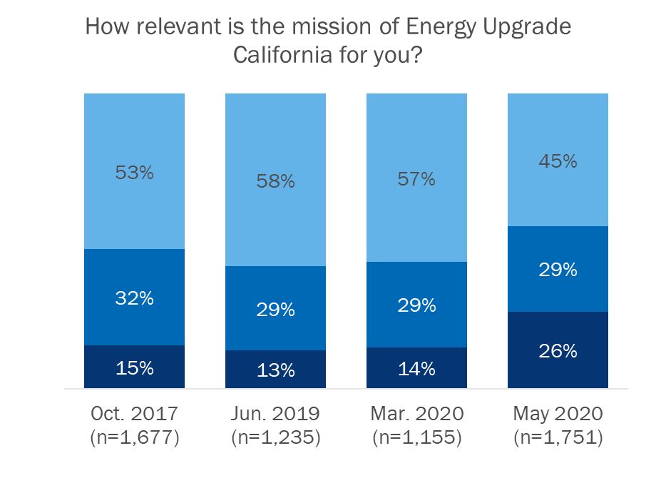
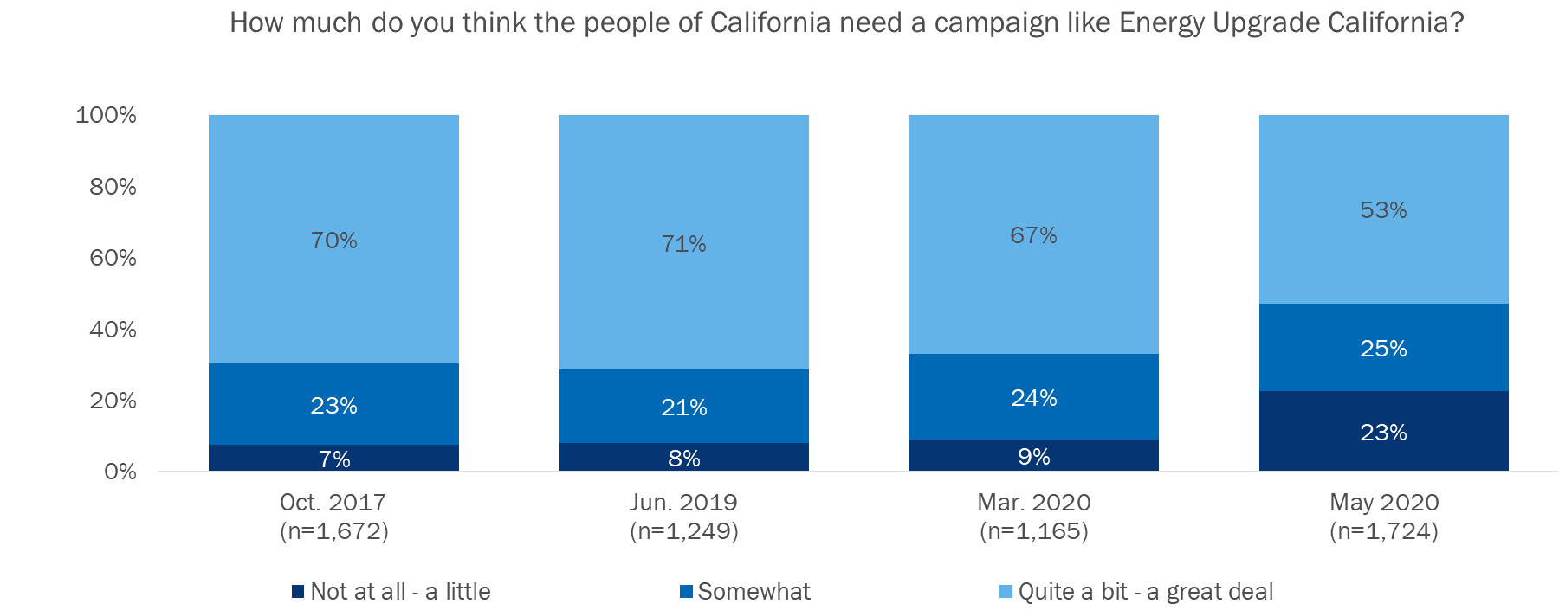
Respondents’ belief in the need for and relevance of EUC has declined since March

Slide 21
ASSESSING CALIFORNIANS’ REACTIONS TO THE COVID-19 CUSTOMER SUPPORT CAMPAIGN

Slide 22


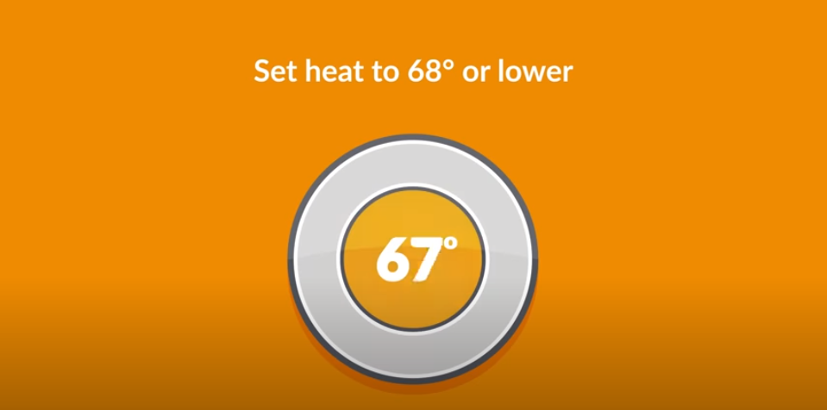
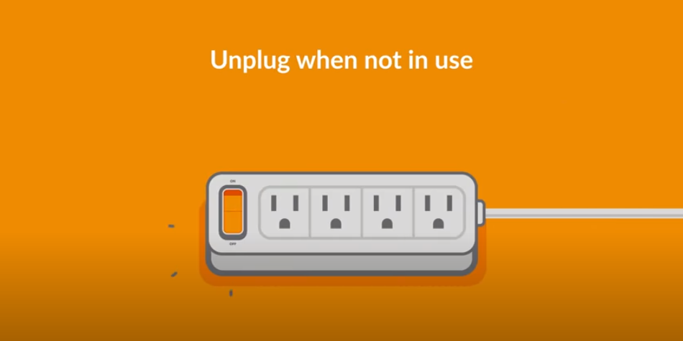


Both the YouTube/TV video and the social media post showed strong levels of aided awareness after less than two months
24% of respondents said that they had previously seen the campaign video on TV or the internet (aided)
14% of respondents said that they had previously seen the campaign content post on Instagram or Facebook (aided)
TV or internet video (snapshots)
Facebook and Instagram post
Note: Opinion Dynamics fielded a survey to measure the effectiveness of the Conserve Energy SoCal campaign designed to promote conservation after the Aliso Canyon gas leak. After the campaign ran for 6 months, the highest level of recall among all videos measured was 24% and the highest recall for any social media post was 17%.

Slide 23
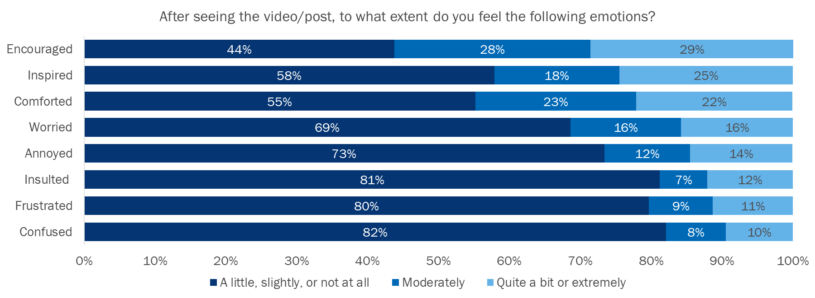
Most respondents had positive emotional reactions to campaign content; a smaller proportion indicated having some negative feelings
Respondents who had previously seen the video/post had significantly stronger emotional reactions to the content (both positive and negative) compared to those who had not previously seen the video/post.

Slide 24
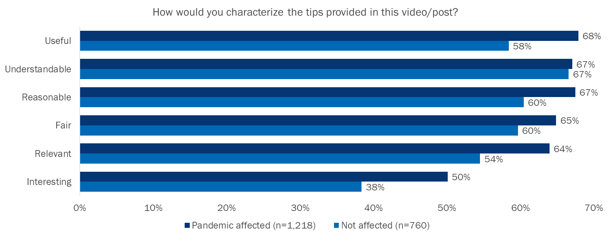
Respondents overall had positive attitudes toward the tips provided in the video/post and there are opportunities to make the assets more interesting

Slide 25
Respondents who saw campaign assets were more likely to recall seeing or hearing something about how to save energy during the SIP
19% (n=369) of respondents were aware of the video or social media post
Of those who were aware of the
video or social media post:
73% (n=268) recalled hearing something about how to save energy while sheltering in place vs. 30% (n=492) of respondents who did not see the assets
Of those who were aware of the
video or social media post:
71% (n=260) recalled hearing something about one or more of the campaign-promoted energy saving tips during shelter in place vs. 27% (n=438) who did not see the assets

Slide 26
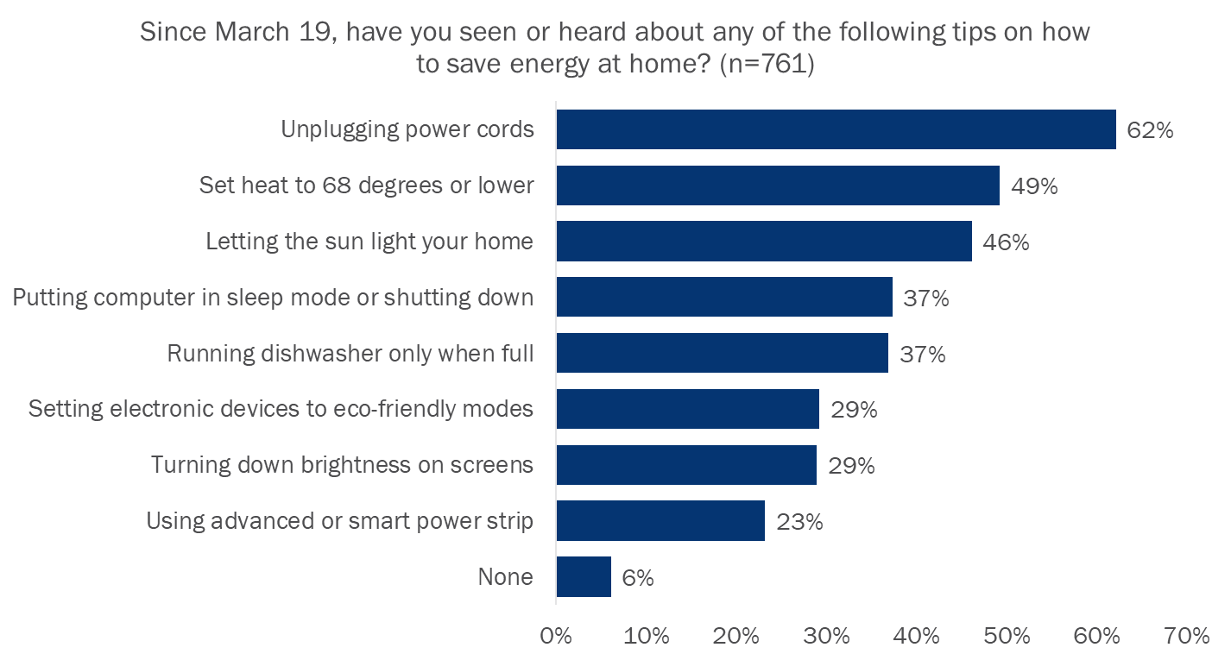

Respondents who had seen or heard about energy saving tips during SIP were frequently aware of campaign-promoted actions
= Campaign-targeted actions

Slide 27
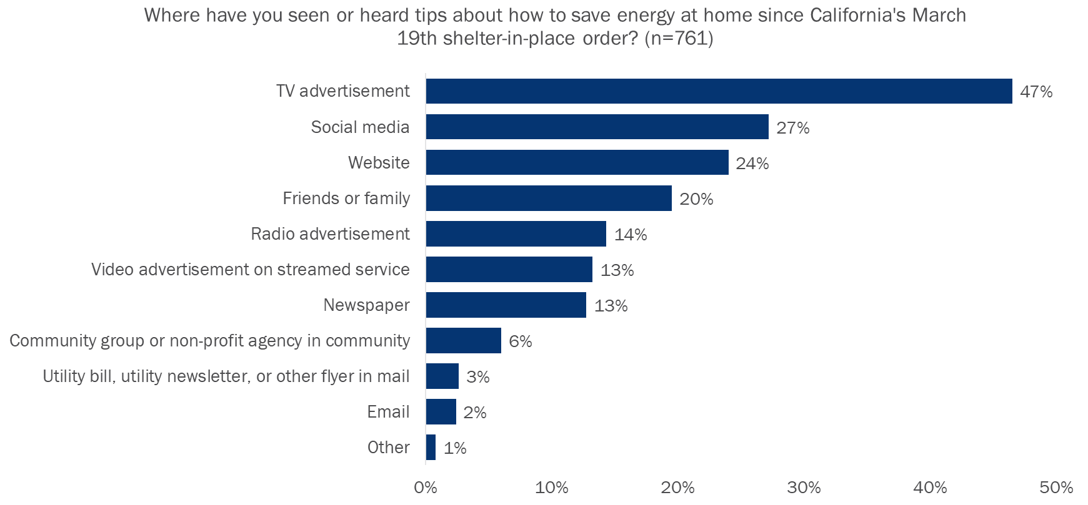
Respondents most frequently reported learning about energy saving tips during SIP through campaign channels that had the greatest reach
= Channel used by the COVID-19 Customer Support Campaign

Slide 28
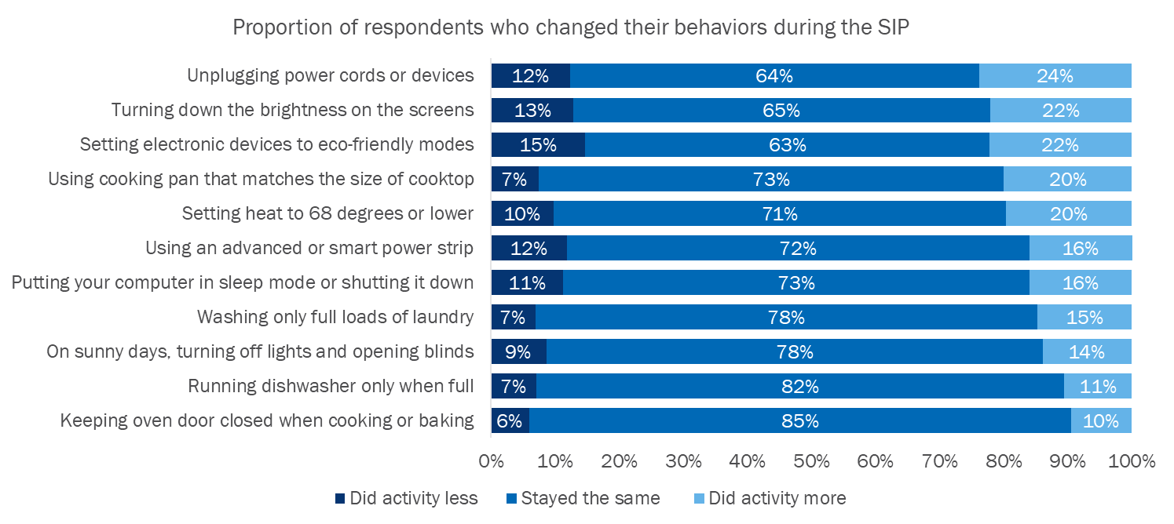
A modest percentage of respondents made energy-saving behavior changes during the SIP
= Campaign-targeted actions
The three behaviors respondents engaged in most frequently are campaign-promoted actions and unplugging power cords or devices was prominently featured in 2019 EUC campaign assets.
Respondents affected by the pandemic were significantly more likely to change their behavior by setting their heat to 68 degrees or lower.

Slide 29
Respondents who were aware of the campaign assets or featured tips changed their behavior more frequently during the SIP
Respondents aware of the social media post, video or campaign-promoted tips showed greater behavior change than unaware respondents in:
  Unplugging power cords
  Using an advanced power strip
  Running the dishwasher only when full
  Setting electronic devises to eco-friendly modes
  Putting their computer in sleep mode
  Turning down brightness of screens
  Keeping the oven door closed
  Using a cooking pan that matches the size of the cooktop
Aware respondents did not show greater behavior change than unaware respondents in:
  Turning off lights and opening blinds
  Washing full loads of laundry

Slide 30
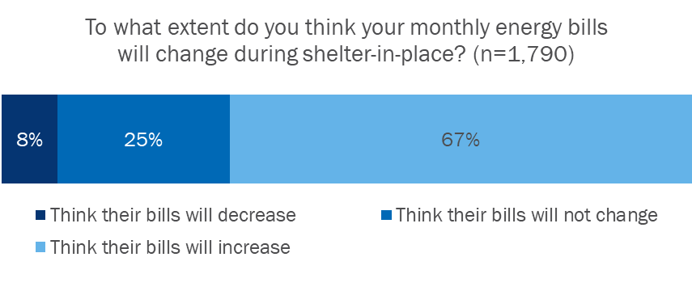
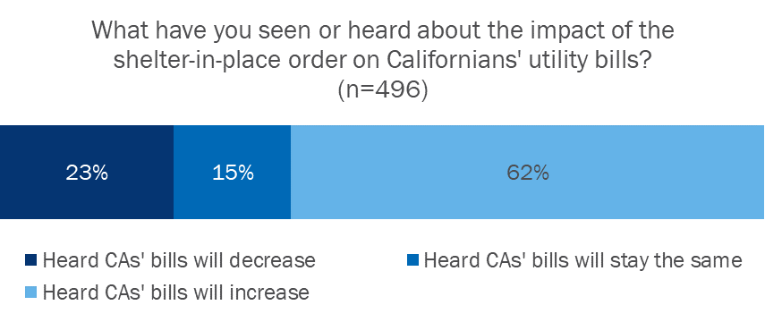
Most respondents were aware their energy bills would increase, even if they had not heard about the impact of shelter in place on Californians’ utility bills
Of all respondents, including those who had not seen or heard anything about the impact of shelter-in-place on CAs’ energy bills, most (67%) indicated they think their monthly bills will increase (n=1,790)
30% of all respondents indicated they had seen or heard something about the impact of the shelter-in-place (SIP) order on Californians’ utility bills
Of those that had heard something about the impact of the SIP, most (62%) indicated they had heard CAs’ energy bills would increase (n=496)
Pandemic-affected respondents were more likely to have heard about the impact of the SIP order Californians’ utility bills

Slide 31
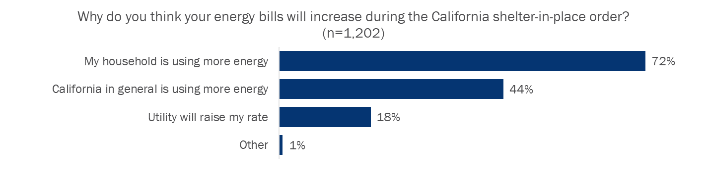
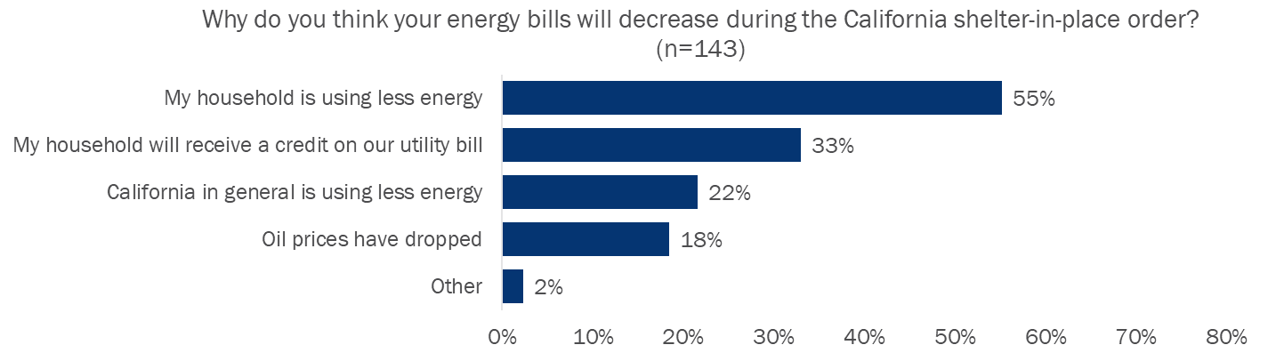
Some respondents showed a lack of understanding about the underlying cause of increased energy bills during the SIP
Note: Multiple responses were allowed.

Slide 32
PERCEPTIONS, ATTITUDES, AND INTENTIONS REGARDING ENERGY MANAGEMENT

Slide 33
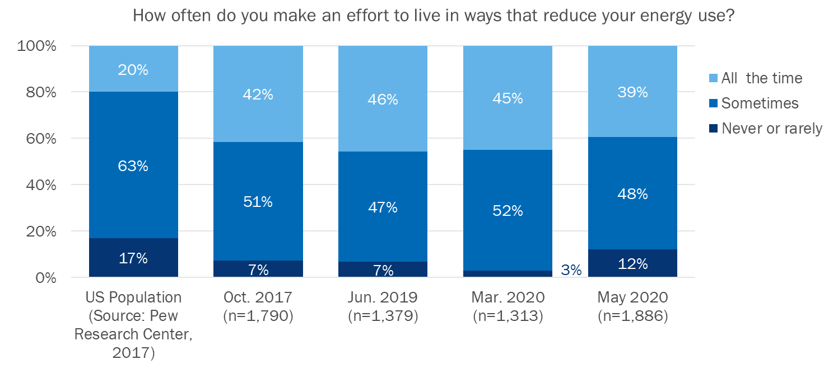
Respondents reported making an effort to reduce their energy less frequently since the beginning of the SIP in March
The March 2020 Tracking Survey was fielded from 3/07/2020 - 03/25/2020 (Statewide shelter-in-place order on 3/19/2020)
12% of respondents said they never or rarely make an effort to live in ways that reduce their energy use, compared to 3% in March.

Slide 34
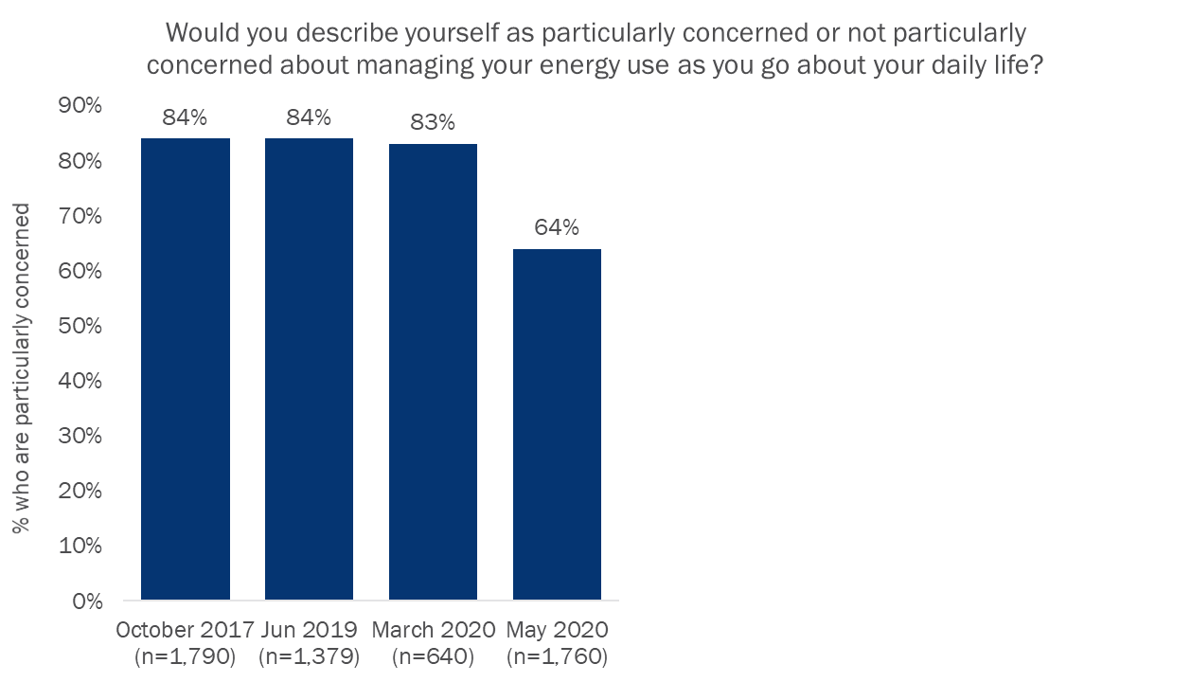
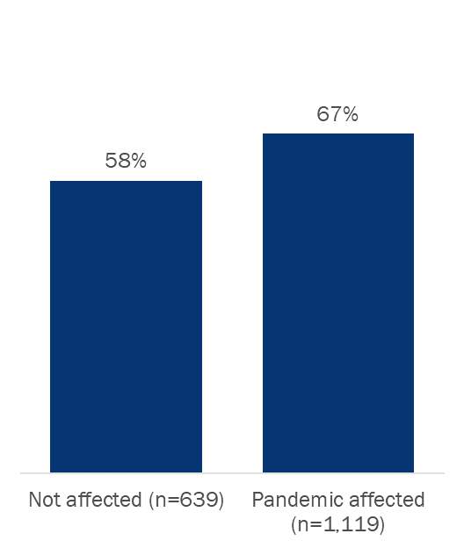
Respondents’ level of concern with managing their energy use decreased significantly during the SIP, though a majority are still concerned
Respondents who are particularly concerned with managing their energy use were more likely to be:
  Nonwhite
  Lower income
  More liberal regarding political ideology
  Higher in CA identity
  Affected by the pandemic
Note: “Don’t know” responses are excluded from the analysis.

Slide 35
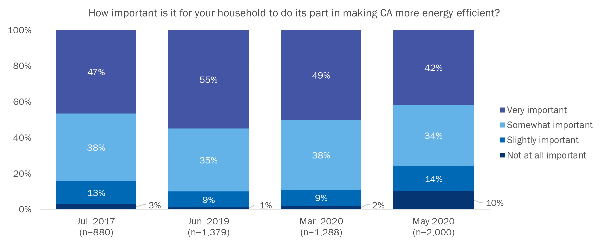
Respondents’ belief in the importance of doing their part to save energy has decreased since the start of the pandemic
Note: “Don’t know” responses are excluded from the analysis.

Slide 36
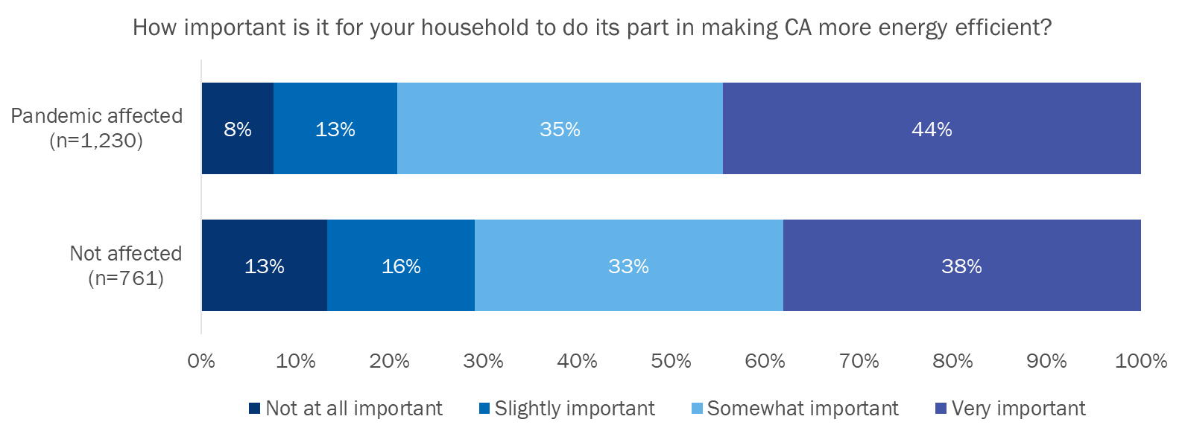
Respondents affected by the pandemic have a stronger belief in the importance of doing their part to save energy

Slide 37
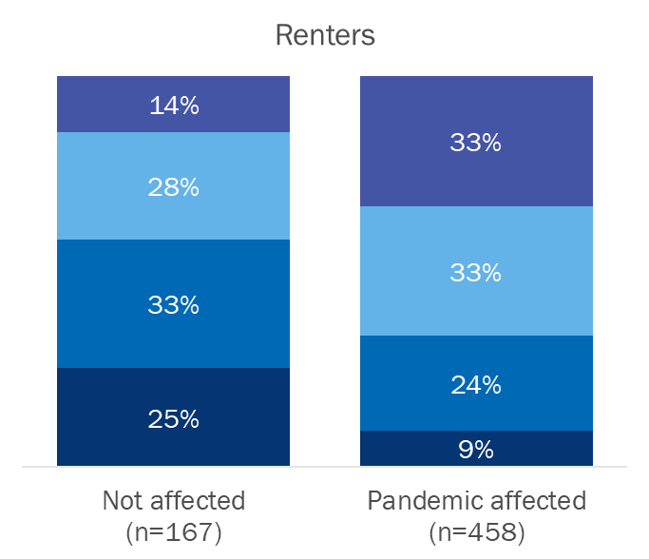
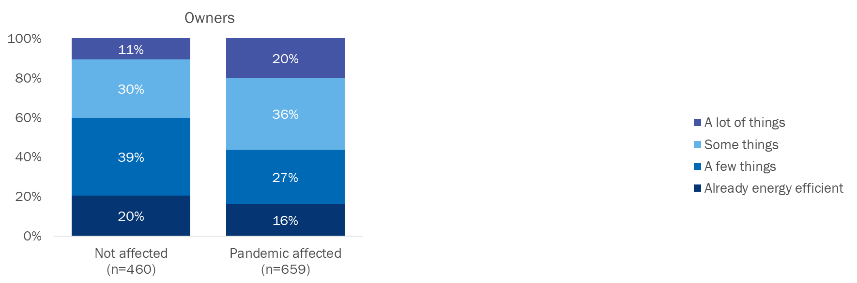
Pandemic-affected owners and renters believe they have more opportunities to make their homes more energy efficient
Think about how much more energy efficient you could make your home. Could you change…
Note: “Don’t know” responses are excluded from the analysis.
Renters reported significantly more remaining opportunities than homeowners.

Slide 38
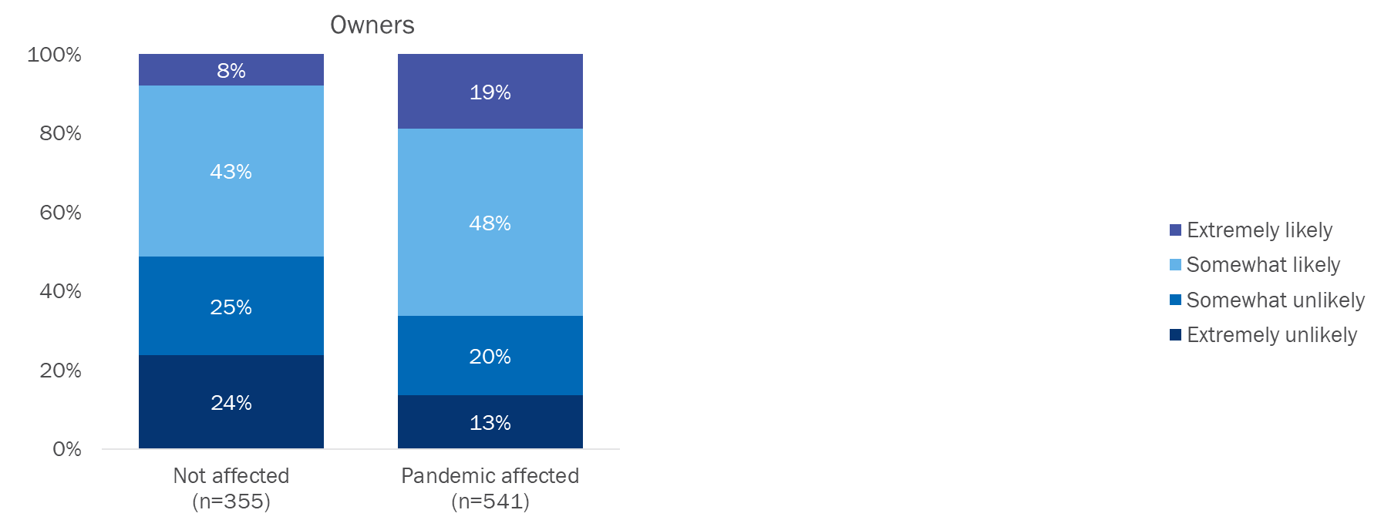
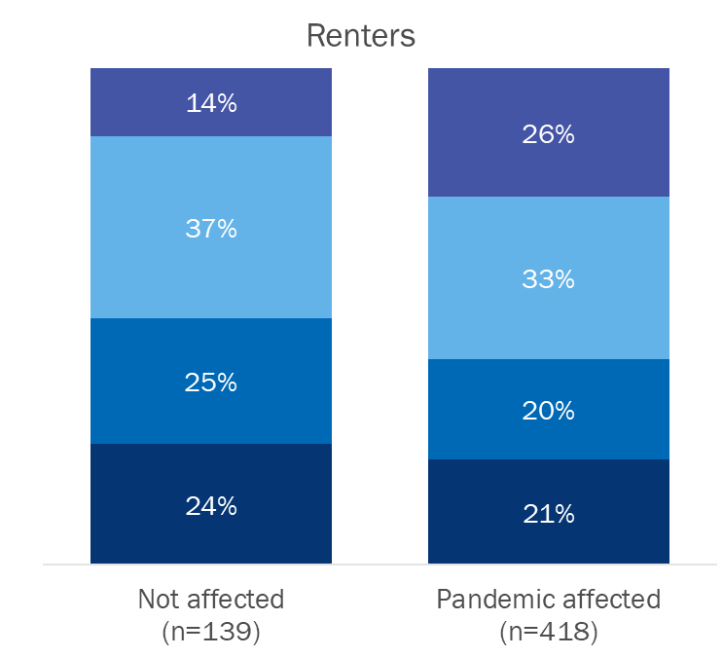
Owners and renters who were affected by the pandemic indicated greater likelihood to make home efficiency upgrades
How likely or unlikely are you to make changes to your home to make it more efficient in the next 12 months?

Slide 39
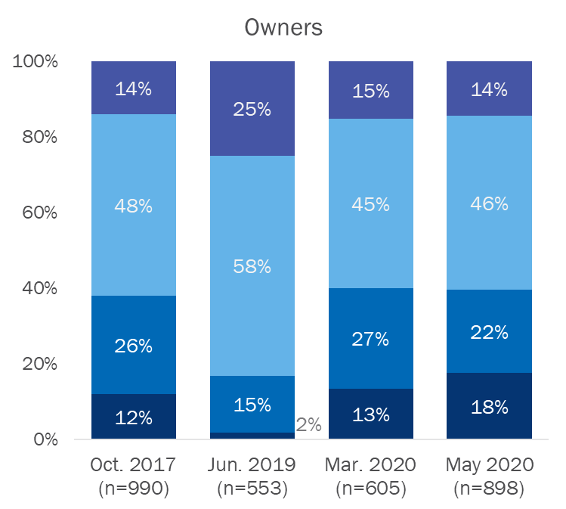
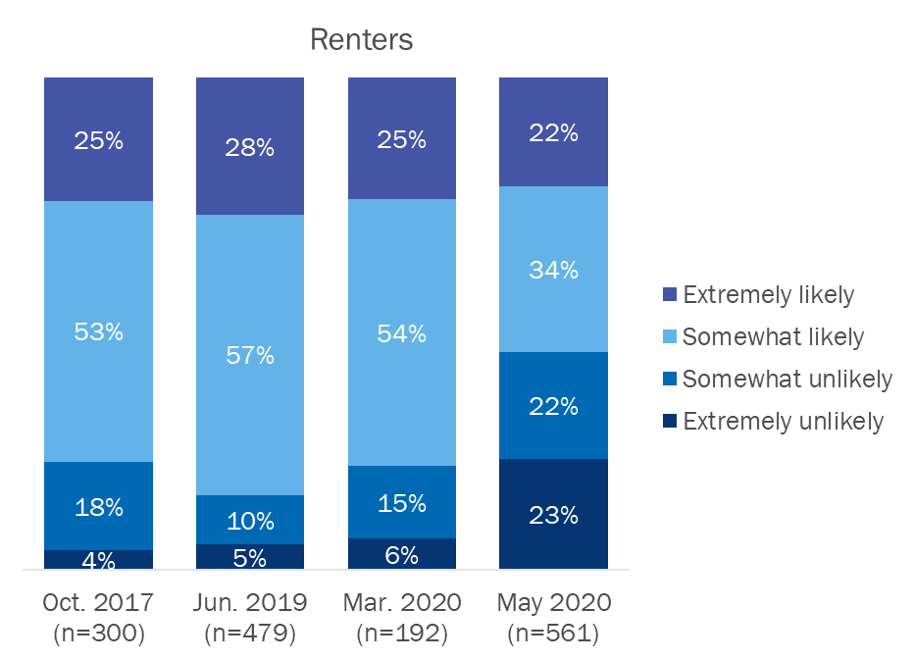
Renters’ likelihood of making home efficiency upgrades has decreased considerably since the SIP started
How likely or unlikely are you to make changes to your home to make it more efficient in the next 12 months?
Note: “Don’t know” responses are excluded from the analysis.

Slide 40
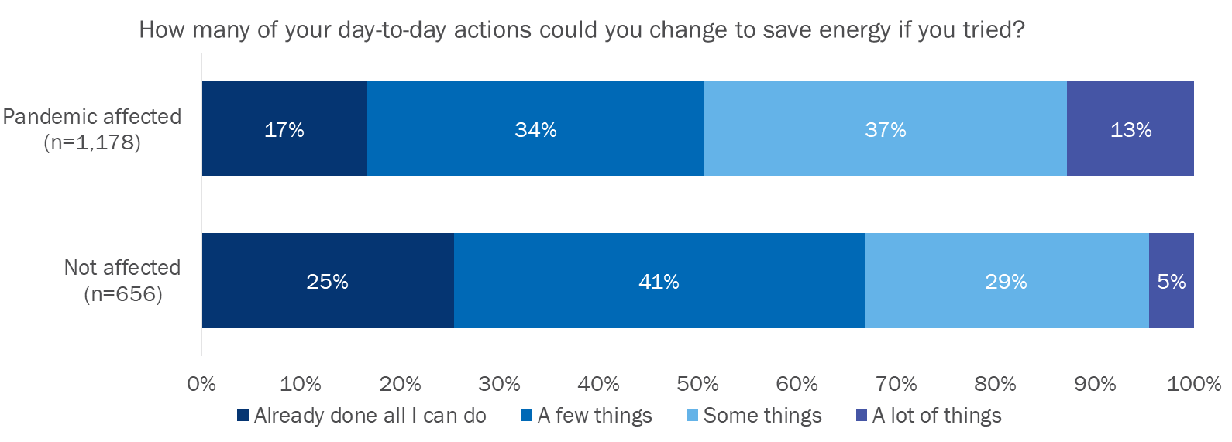
Respondents affected by the pandemic indicated having more opportunities to change their day-to-day actions to save energy
Note: “Don’t know” responses are excluded from the analysis.

Slide 41
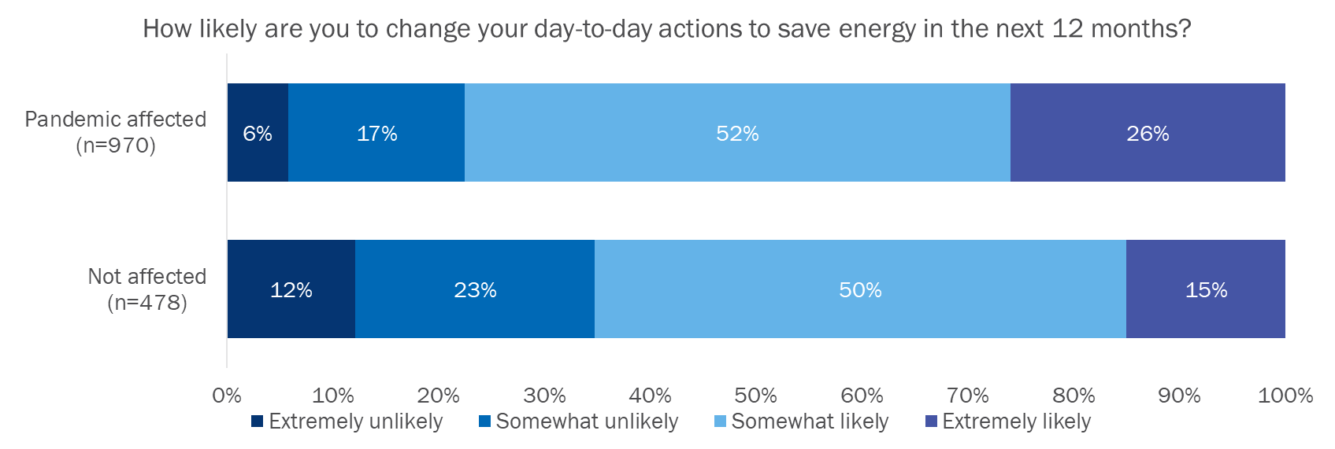
Respondents affected by the pandemic indicated greater likelihood of changing their day-to-day actions to save energy
Note: “Don’t know” responses are excluded from the analysis.

Slide 42
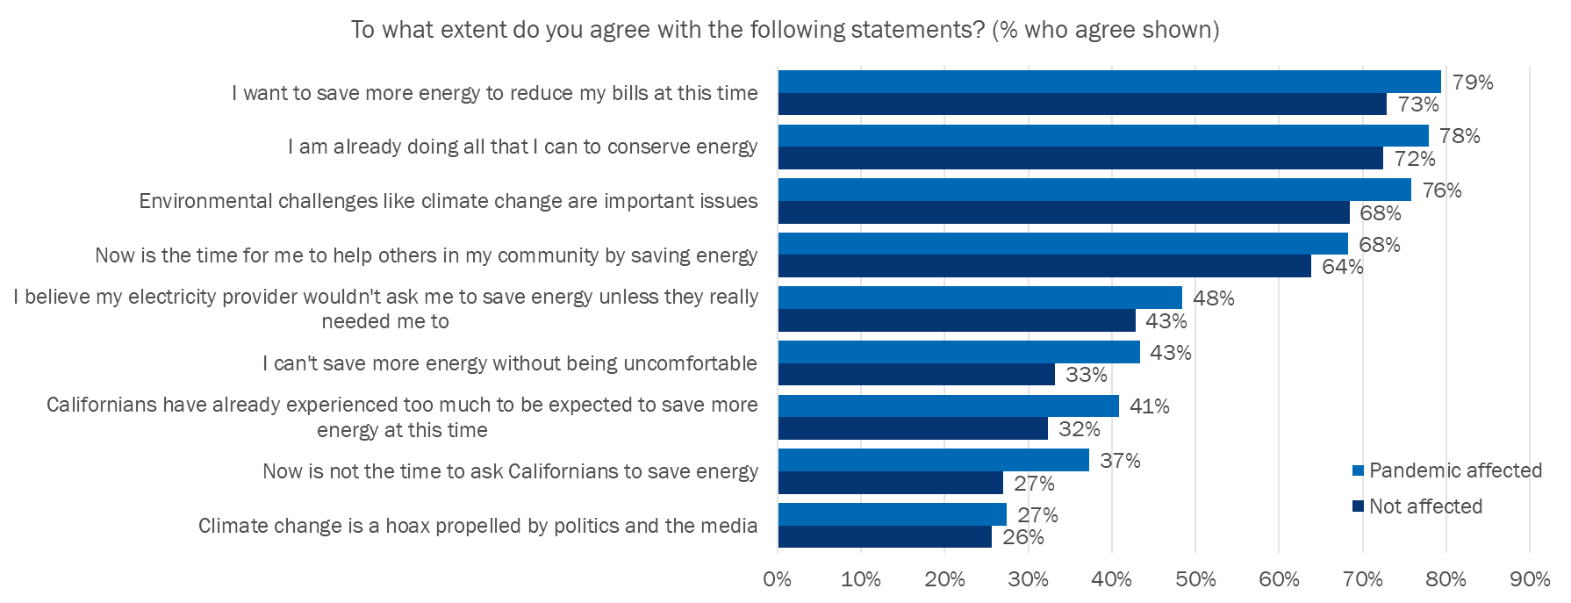
Respondents have a strong desire to reduce their bills, though most believe they are already doing all that they can to conserve
*
*
*
*
*
*
Note: * denotes significant different between respondents who have been affected by the pandemic and those who have not
Over a quarter of respondents agree that climate change is a hoax.

Slide 43
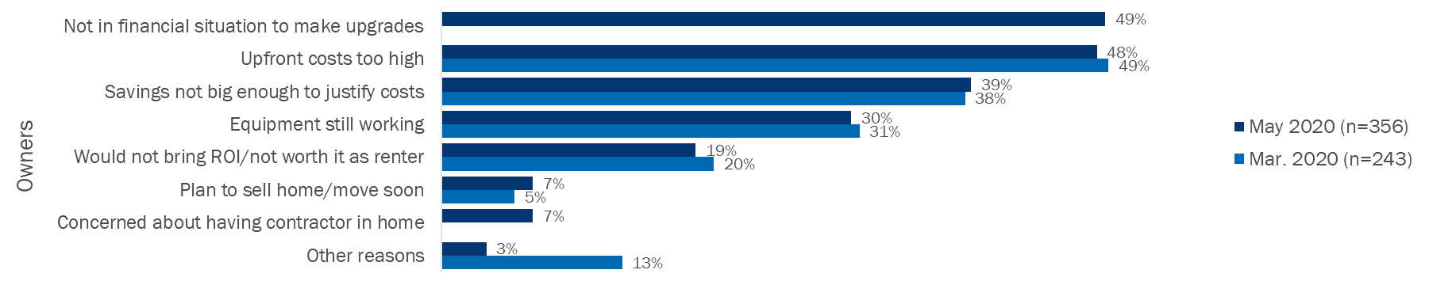
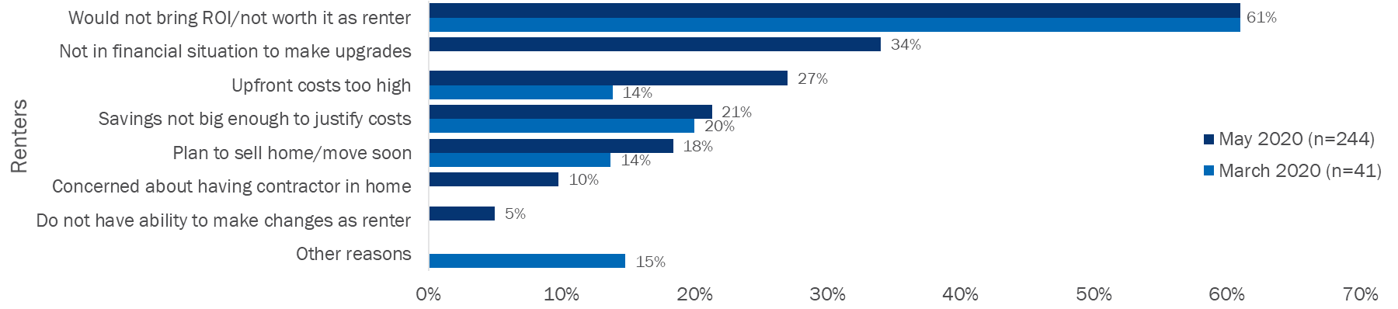
Financial barriers continue to be the main reason why owners and renters are unlikely to make home upgrades
Why are you unlikely to make your home more energy efficient?
Note: Multiple responses were allowed. These questions were asked only if they indicated unlikely to take actions in the next 12 months.

Slide 44
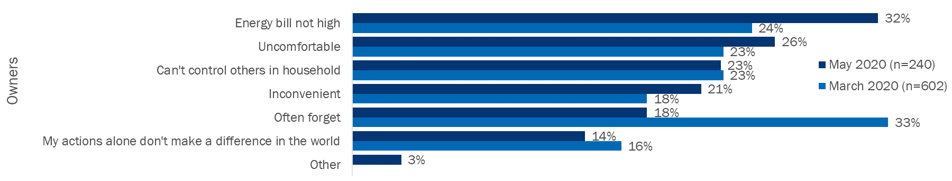
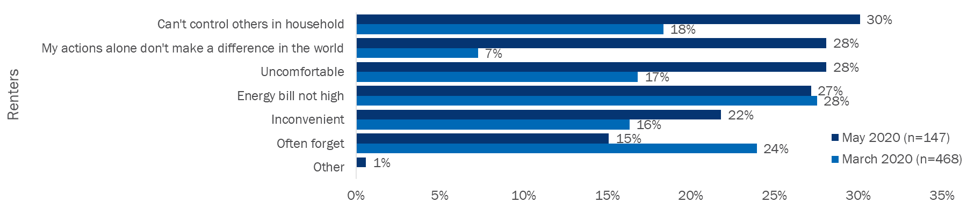
Renters increasingly face barriers related to perceived control of their energy use and home comfort during SIP
Why are you unlikely to change your actions to save energy?
Note: Multiple responses were allowed. These questions were asked only if they indicated unlikely to take actions in the next 12 months.

Slide 45
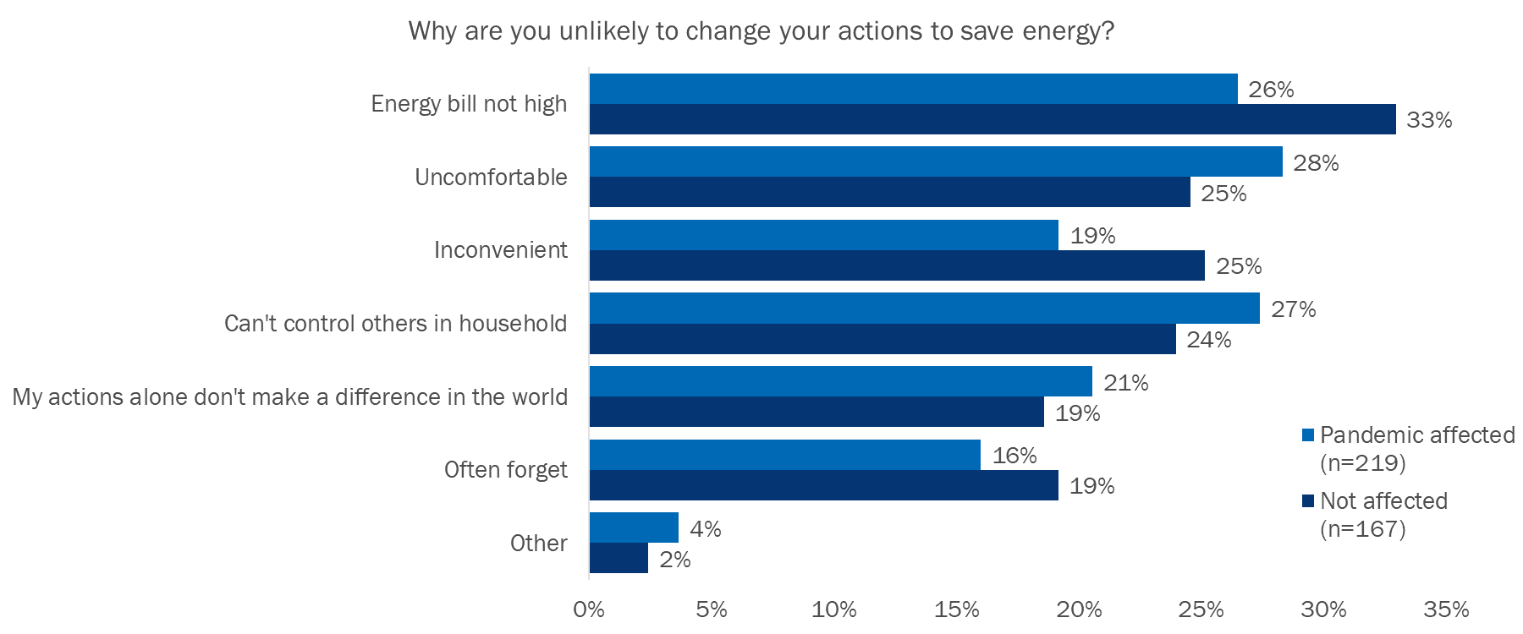
Respondents’ reasons for not changing their actions to save energy do not significantly differ by whether they were affected by the pandemic
Note: Multiple responses were allowed. These questions were asked only if they indicated unlikely to take actions in the next 12 months.

Slide 46
CHANGES IN MEDIA CONSUMPTION

Slide 47
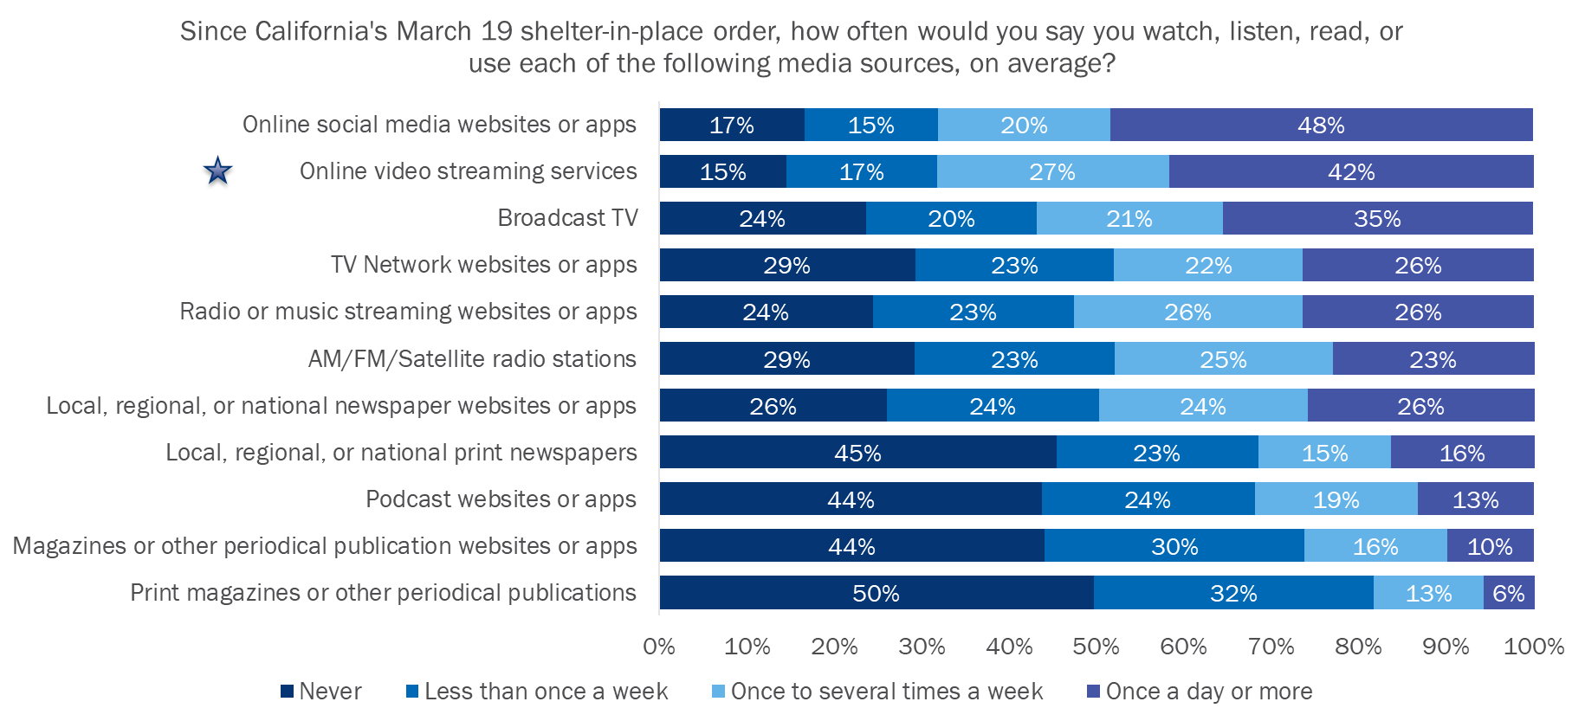
Respondents most frequently used social media, video streaming, and TV during the SIP
= sources used by DDB to share campaign content

Slide 48
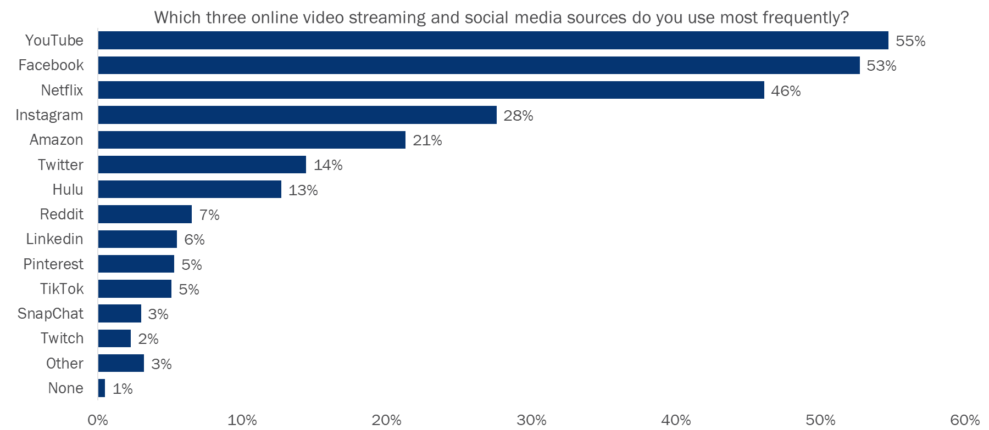
YouTube, Facebook, and Netflix are the most frequently used online video streaming and social media sources
n=1,827
= sources used by DDB to share campaign content

Slide 49
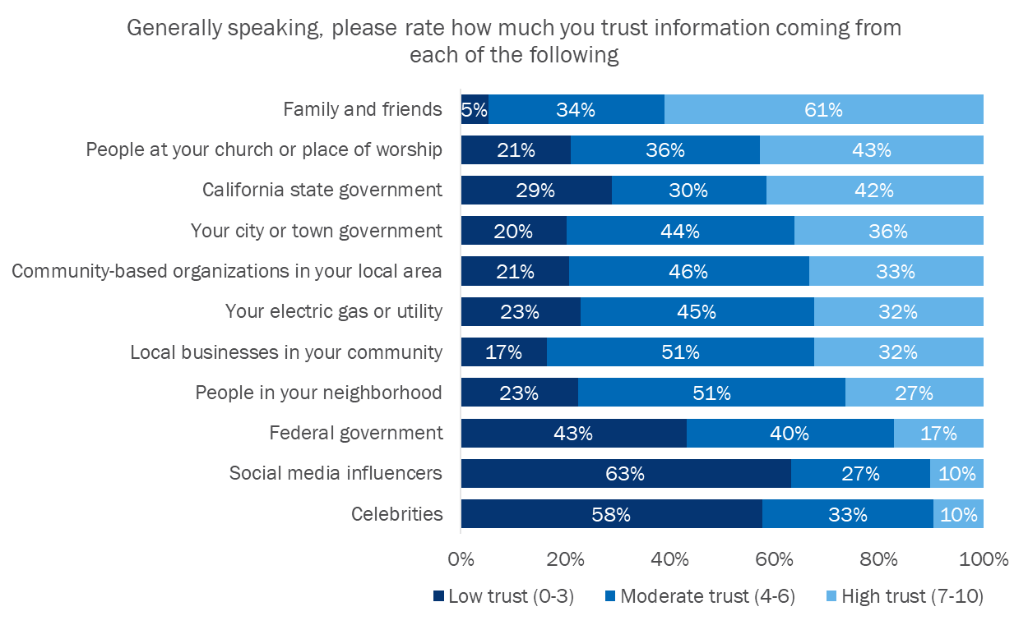
Californians have the highest levels of trust in friends and family, people at church and the lowest trust in the federal government, influencers, and celebrities
Conservative political ideology was associated with:
  More trust in people in their community, people at their church, local businesses, the federal government, and family and friends
  Less trust in their city or town government, the California state government, celebrities, and CBOs
Note: Question asked on a 0-10 scale. Responses were binned into low, moderate, and high trust.

Slide 50
CALIFORNIANS’ IDENTITY AS CALIFORNIANS

Slide 51
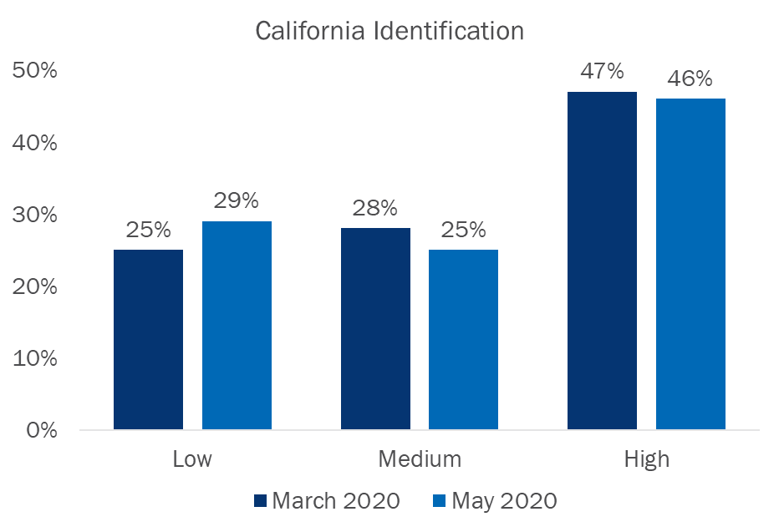
California Identity
Less than half of Californians highly identify with their state
Almost one third currently have low identification as Californians
Respondents who are politically liberal, Hispanic, and lower income show higher identification as Californians
Measure includes: Respondents’ perceived importance of being a Californian to their identity, and feeling strong ties to Californians as a group

Slide 52

IMPLICATIONS OF THE RESEARCH FINDINGS TO EUC

Slide 53

Key Takeaway #1: Californians responded positively to the COVID-19 Support Campaign and a modest percentage are taking the recommended energy-saving tips
A significant portion of respondents were aware of the video and website assets after less than two months of the campaign
Most respondents had positive reactions to the campaign messaging and content and believe they should do their part to save energy during the pandemic
Respondents most financially impacted by the pandemic were more likely to evaluate the campaign ads as useful, relevant, reasonable, fair, and interesting
Respondents who were aware of the campaign assets or featured tips changed their behavior more frequently during the SIP

Slide 54
Recommendation #1: Continue to leverage the EUC brand as a crisis communication tool
The results showing that customers are receptive to energy conservation messaging and follow through with behavior changes aligns with results from other studies conducted during times of crisis
As such, the CPUC may want to consider continuing to leverage EUC as a tool to support customers during the pandemic and for emergencies such as wildfires – especially when using a helpful tone and messaging

Slide 55
Key Finding #2: Californians are facing new energy conservation barriers during the pandemic which have disproportionate impacts across customer groups
More than 75% of respondents believe they are doing all that they can to save energy
Renters’ likelihood of making energy efficiency home upgrades
has decreased considerably since the start of the pandemic and they increasingly face barriers related to perceived
control of their energy use and home comfort during SIP
Respondents who were affected by the pandemic indicated greater likelihood of making home efficiency upgrades and changes their day-to-day actions to save energy

Slide 56
Recommendation #2: Continue to ensure that campaign assets acknowledge pandemic impacts and the new barriers that customers face
Consider continuing to use an empathetic tone to messaging
Continue to focus primarily on promoting low and no-cost actions and upgrades
Consider acknowledging the constraints that customers (especially renters) face to saving energy while staying at home and continue to position EUC as a supportive resource
Ensure that renters are reflected in campaign assets

Slide 57
Key Finding #3: There are opportunities for improvement in COVID-19 Support Campaign messaging and outreach strategies
Overall, the campaign channels aligned with the media sources Californians are using most frequently, though there may be opportunities to further leverage online streaming platforms
Fewer than half of Californians are highly identified with their state, likely driven by political ideology
Perceived relevance, need for, and trust in the EUC brand
has declined since March
Fewer than half of respondents found the video and
Instagram post “interesting”
Respondents have the lowest levels of trust in information that comes from influencers and celebrities

Slide 58
Recommendation #3: Consider adapting current messaging and outreach strategies to better reach respondents during the pandemic
Consider using segmentation to develop alternate messaging strategies to reach Californians that do not identify with California-centric branding and communal messaging
Explore opportunities to further utilize online video streaming platforms (e.g. Amazon prime and Hulu)
While initial campaign assets were necessarily simple due to time constraints, consider developing more interesting content that further engages customers for future campaign iterations
Choose the messages and information communicated through influencers and celebrities cautiously

Slide 59
Contact Information:
Hannah Howard
Managing Director/V.P.
HHoward@opiniondynamics.com
510-214-0183
Hilary Polis
Managing Consultant Hpolis@opiniondynamics.com
510-214-0181

Slide 60

APPENDIX

Slide 61
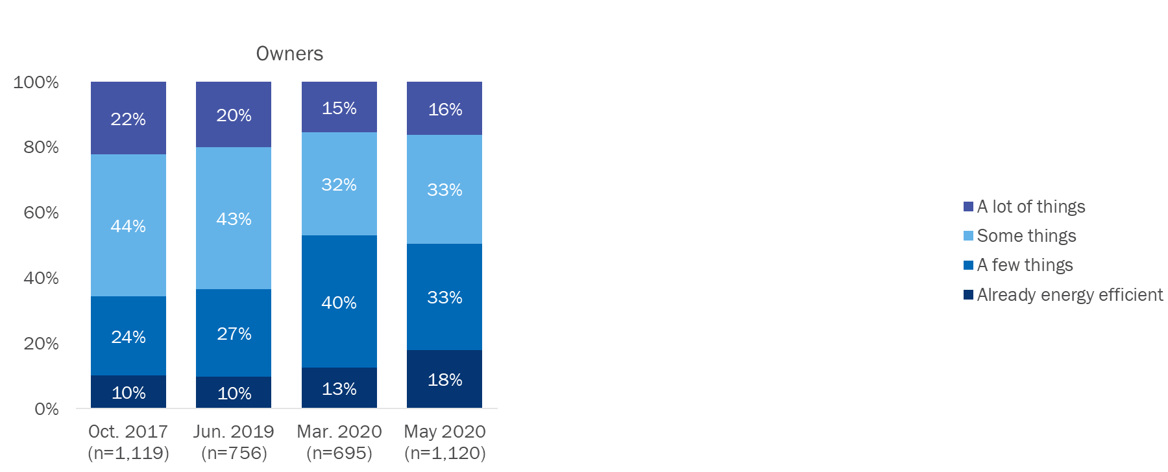
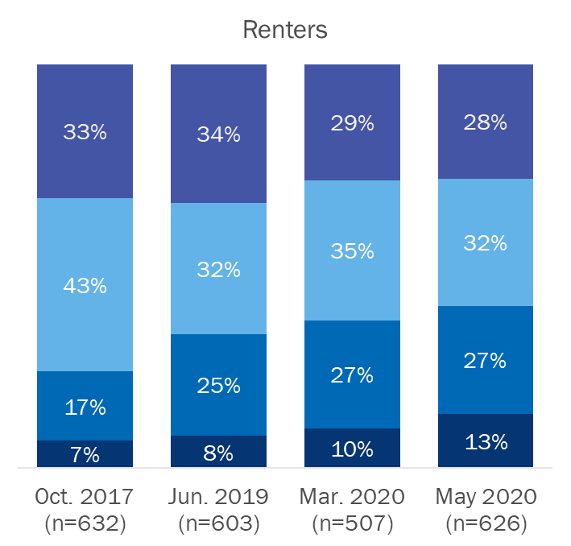
Renters’ and owners’ perceived opportunities to make their homes more energy efficient have decreased since the SIP started in March
Think about how much more energy efficient you could make your home. Could you change…
Note: “Don’t know” responses are excluded from the analysis.

Slide 62


Renters’ perceived opportunities to change their day-to-day actions to save energy have decreased slightly since the SIP started
How many of your day-to-day actions could you change to save energy if you tried?
Note: “Don’t know” responses are excluded from the analysis.

Slide 63


Both owners and renters’ likelihood of changing their day-to-day actions to save energy have decreased slightly since the SIP started
How likely are you to change your day-to-day actions to save energy in the next 12 months?
Note: “Don’t know” responses are excluded from the analysis.

Slide 64

Respondents have a strong desire to reduce their bills, though most believe they are already doing all that they can to conserve
Respondents who believe Californians have already experienced too much tend to be more affected by the pandemic, politically conservative, lower in education, and lower in income
About a third (38%) of respondents do not disagree that climate change is a hoax

Slide 65

Respondents’ attachment to their city or town has decreased since 2017
Over one quarter of respondents (26%) feel little to no attachment to their city or town

